Slide 1



Temptation & Death
By brad jackson

Slide 2

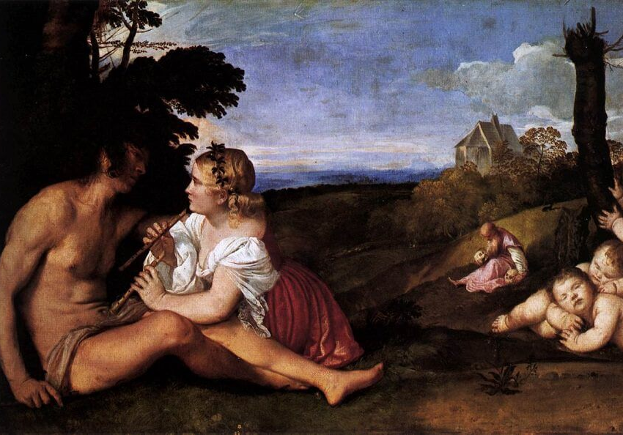
Three Ages of Man
The struggle between man and temptation is a trend as old as time and its affects are inevitable.
My first artifact is Three Ages of Man, a painting by Tiziano Veccellio. Tiziano was known as Titian by the English. Three Ages of Man was painted around 1515 in Italy (Bertman, 2001).
young, passionate, couple. The woman seems to be tempting the man with a pair of flutes. To the right of them is a trio of children who resemble cupids, perhaps the product of their love. Adjacent to the children is a man holding a pair of skulls.

Slide 3
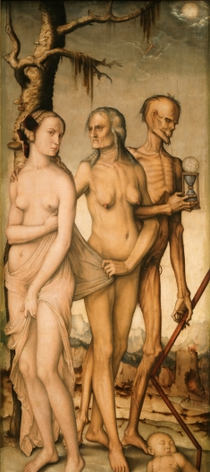
The Ages of Woman and Death
Painted by Hans Baldung Grien.
It was painted between 1541 and 1544 in Strasbourg, France (Museo Nacional del Prado, 2019).
The Ages of Woman and Death depicts a ghastly demon whose arm is locked with an old woman. The old woman is pulling at the clothing of younger woman who is clearly upset. A tear rolls down her cheek as the old woman is tempting her to join them. The demon is holding an hourglass and a spear. At the end of the spear is a child which rests on the ground.

Slide 4
Impact and Relevance
The idea that our actions in life determine the quality of our afterlife is something that I do not believe in; however, I do believe in making good decisions to better the earthly lives of myself and those around me.
This message could be useful to a social worker.
Social workers help people who are at a low point in their lives.
Some of this strife is caused by chance and a series of unfortunate events but it is my observation that most of the cause of low points in peoples' lives is due to poor decision-making skills.

Slide 5
Evidence
Chronologically, my artifacts were made about 30 years apart. Not much changed in terms of day-to-day living between these times. The world was wrought with disease, famine, and war. Both works were created "in an age when people died so young" (Bertman, 2001).
In my experience, the religious symbolism in these pieces can simply represent having morals. It is important to have strong, clearly defined, morals and to do the right thing no matter how hard it is.
From my own experiences I understand the struggle of escaping from something that seems like an ill-fated situation.

Slide 6
Personal Experience
From my own experiences I understand the struggle of escaping from something that seems like an ill-fated situation.
I always chose to hang out with the wrong crowd over lifelong friends and often wondered why I was in horrible situation x.
As time passed on my trend of bad decision making continued. During my first stint in college I hung out with thugs and drug addicts.
When I dropped out, I found myself in one toxic relationship after another.
Appreciation of the humanities, such as the cultural melting pot of Star Trek and even my own artistic outbursts lead me to a deeper understanding of myself. Eventually, having grown tired of my reciprocating downward trajectory, I found a way out through a family friend. She helped me get a job with the potential of expanding to a career.

Slide 7
Studying the Humanities
It would be useful to have a working knowledge of the humanities to draw comparisons from the past to compare to the occurrences in the lives of struggling adults and children.
Appreciation of the humanities, such as the cultural melting pot of Star Trek and even my own artistic outbursts lead me to a deeper understanding of myself and I believe it will benefit you in the same way.

Slide 8
Importance of the Humanities
The humanities are important to society to remind us not to reinvent the wheel.
Through thousands of years of human consciousness many ideas have been expressed and as time goes on, people draw from the past for solutions to modern problems.
Even during the renaissance, much was understood about patterns of the human psyche. It is useful to have an understanding of past beliefs because they are often based in a universal truth.
Drawing from past human experiences gives us a deeper understanding of the human condition and saves us the trouble of grappling with the entirety of our species’ timeline.

Slide 9
References
Bertman, S. (2001, February 6). Three Ages of Man. Retrieved March 29, 2020, from http://medhum.med.nyu.edu/view/10361
Museo Nacional del Prado (2019). The Ages of Woman and Death - The Collection. Retrieved March 29, 2020, from https://www.museodelprado.es/en/the-collection/art-work/the-ages-of-woman-and-death/d5ef2c3e-48d1-40a8-8bb7-745314a1197c
The National Gallery. (2020). Titian. Retrieved March 29, 2020, from https://www.nationalgallery.org.uk/artists/titian
Three Ages of Man, 1515 by Titian. (2011). Retrieved March 29, 2020, from https://www.titian.org/three-ages-of-man.jsp

